Slide 1
The War on Drugs
Mandatory Minimums

Slide 2
Federal Law – Mandatory Minimum Sentencing
Generally, when a person is convicted of a crime, the punishment is determined by the court (i.e. the judge).
How does a Judge figure out the appropriate punishment?
The judge can use various factors:
See https://www.ussc.gov/guidelines/2016-guidelines-manual
Aggravating Factors | Mitigating Factors
Criminal History | Minimal/Minor Participant
Cooperation | Emotional/Mental Condition
Use of Weapon (firearms?) | Remorse/Contrition

Slide 3
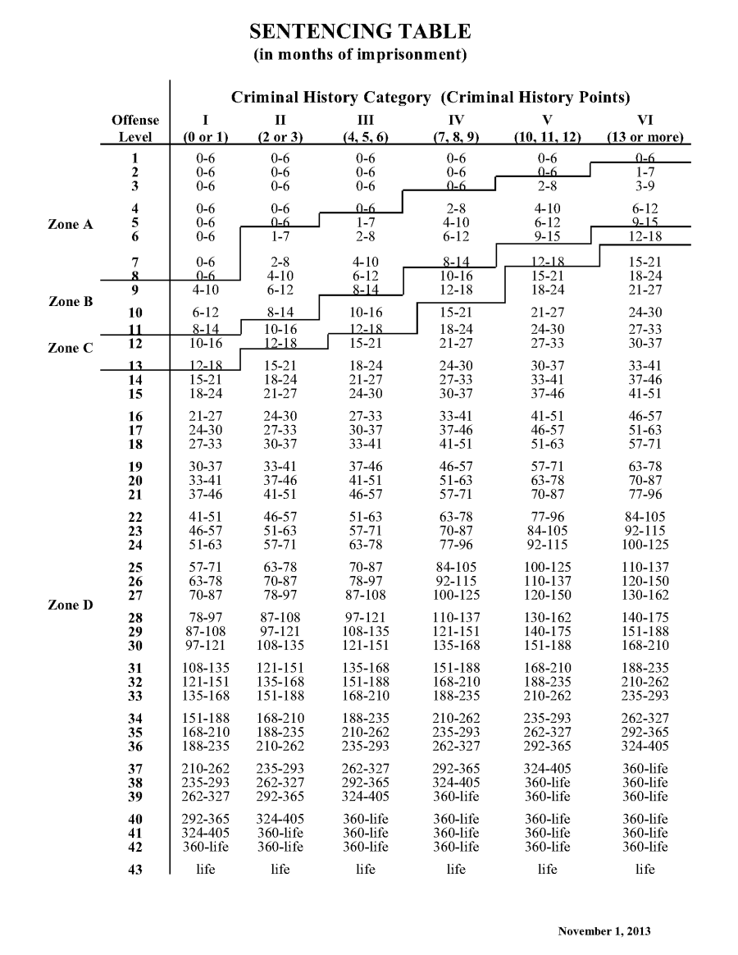

Slide 4
Federal Mandatory Minimums
In 1986, Federal Law was changed to include mandatory minimum sentencing for many drug crimes.
76% of convictions→ non-mandatory sentencing
24% of convictions→ mandatory sentencing
Almost all of these are drug-related convictions

Slide 5
Federal Mandatory Minimums
How it works:
Upon conviction of a criminal offense, if certain additional criteria are met, a mandatory minimum sentence must be applied.
Criteria can be classified three ways:
Penalties triggered by offense characteristic or elements of the offense
Penalties triggered by reference to another offense
Penalties triggered by the offender’s criminal history

Slide 6
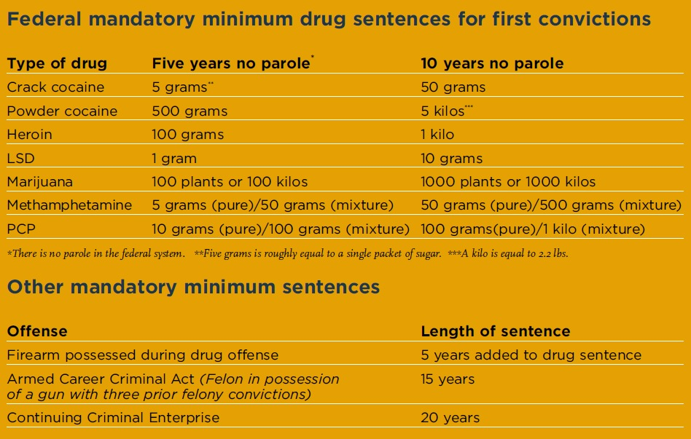

Slide 7
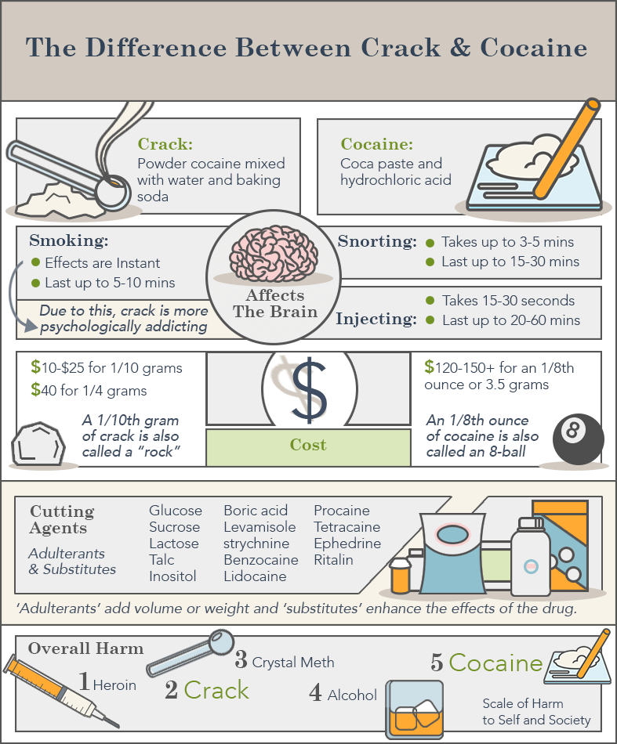

Slide 8
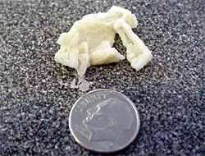
Crack cocaine (~5g):

Slide 9
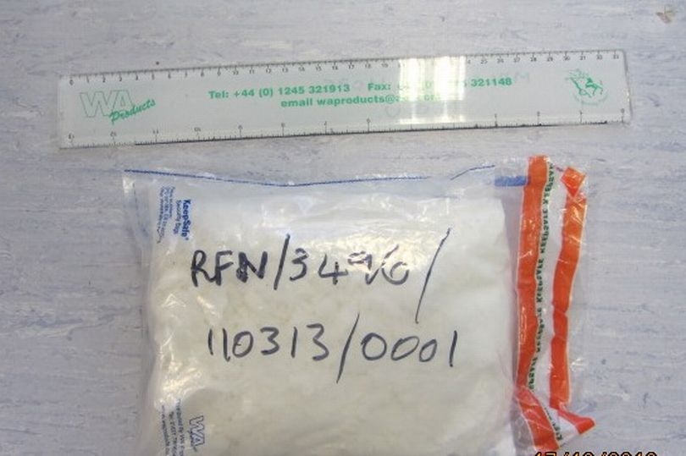
Powder Cocaine (~500g):

Slide 10
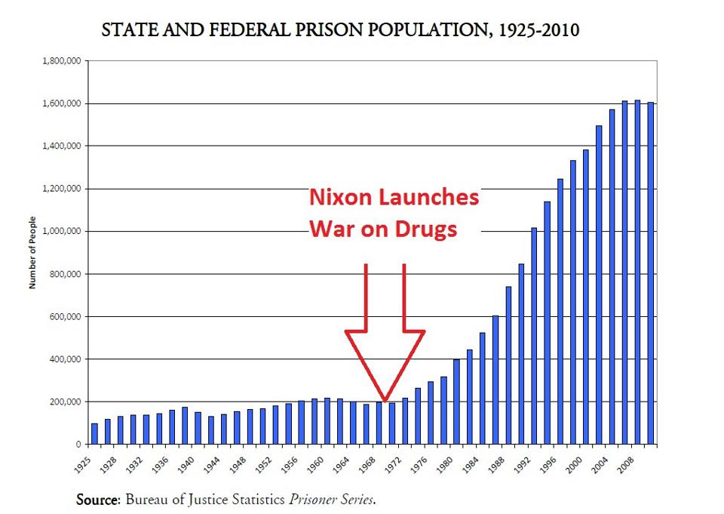

Slide 11
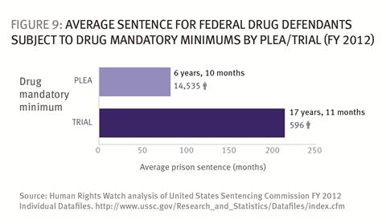

Slide 12
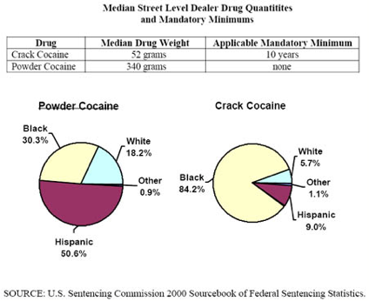

Slide 13
Statistics from the 2012 National Survey on Drug Use and Health reveal that 55% of past-month crack users are white.
Africa Americans, who make up 12.2% of the population, account for 37% of crack users, meaning that they are 3.5 times more likely than whites to be regular crack users.
African Americans are 21.2 times more likely than white people to go to federal prison on a crack charge.

Slide 14
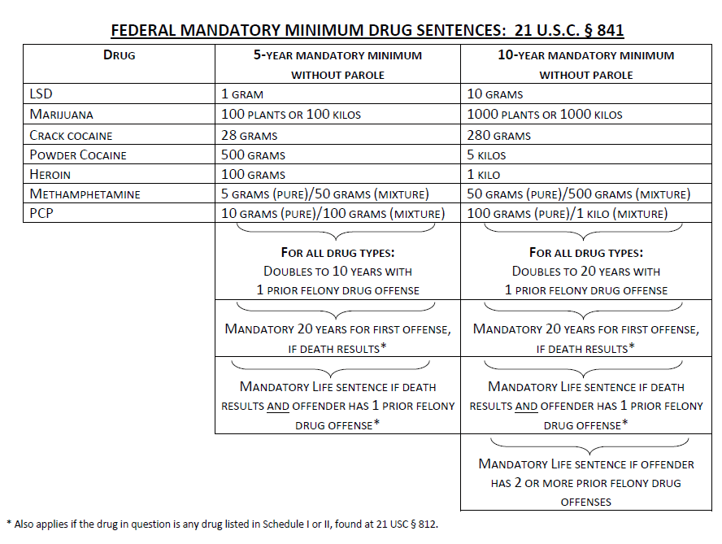
2010 Reforms

